Slide 1
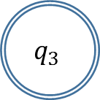
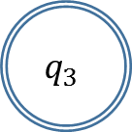
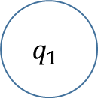


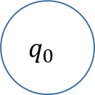






1
1
0
$$q_{0}$$
0
$$q_{1}$$
0
$$q_{2}$$
0
1
1
$$q_{0}$$
1
$$q_{1}$$
0
$$q_{2}$$
1
0
0
0
$$q_{3}$$
$$q_{1}$$
0
$$q_{3}$$
0
$$q_{0}$$
1
1
1
0
0
1
$$q_{2}$$
$$q_{4}$$
1
1

